Slide 1
Agenda
1. Welcome and introductions
2. Adopt minutes of Meeting #7
3. Update on Richmond Middle School sampling
4. Update on CRREL building investigations
5. Peer review (postponed) – overview of process and questions
6. Update on soil vapor extraction pilot project (if time available)
7. Next meeting: Agenda, Date and Location – April 8 or 15
8. Comments & questions from the public
9. Adjourn

Slide 2
On-Going and Completed Work Since Last Meeting in November
Remedial Investigation Work
Soil Vapor Extraction Pilot Study
Initiate Draft of the Remedial Investigation Report
Vapor Intrusion Mitigation/Protection of Human Health Work
Continued regular monitoring of indoor air quality in Main Laboratory
Cold Room Building Materials and Legacy Infrastructure Characterization
Installed Duckbill Check Valve in Roof Drain Piping in MPR
Replaced 200 Healthmate Air Filters
Conducted Richmond Middle School Indoor Air Sampling

Slide 3
Richmond Middle School Makes the News – Indoor Sampling Update
RMS sampled 4 times in December & January
1) December 29th – Sample with BottleVacs
December 30th - Contaminated Equipment Blanks
2) January 19th – Sample with Summas
Elevated Concentrations in Cafeteria and Background Location South of the Cafeteria Reported by the Lab on January 23rd
3) January 23rd – Hapsite Screening - Each Location Non-Detect
4) January 24th- Summa Non-Detect to Very Low Levels

Slide 4
CRREL Building Investigations
Engineering Evaluation of the -73 Line
Installation of Duckbill Valve in Multi-Purpose Room

Slide 5
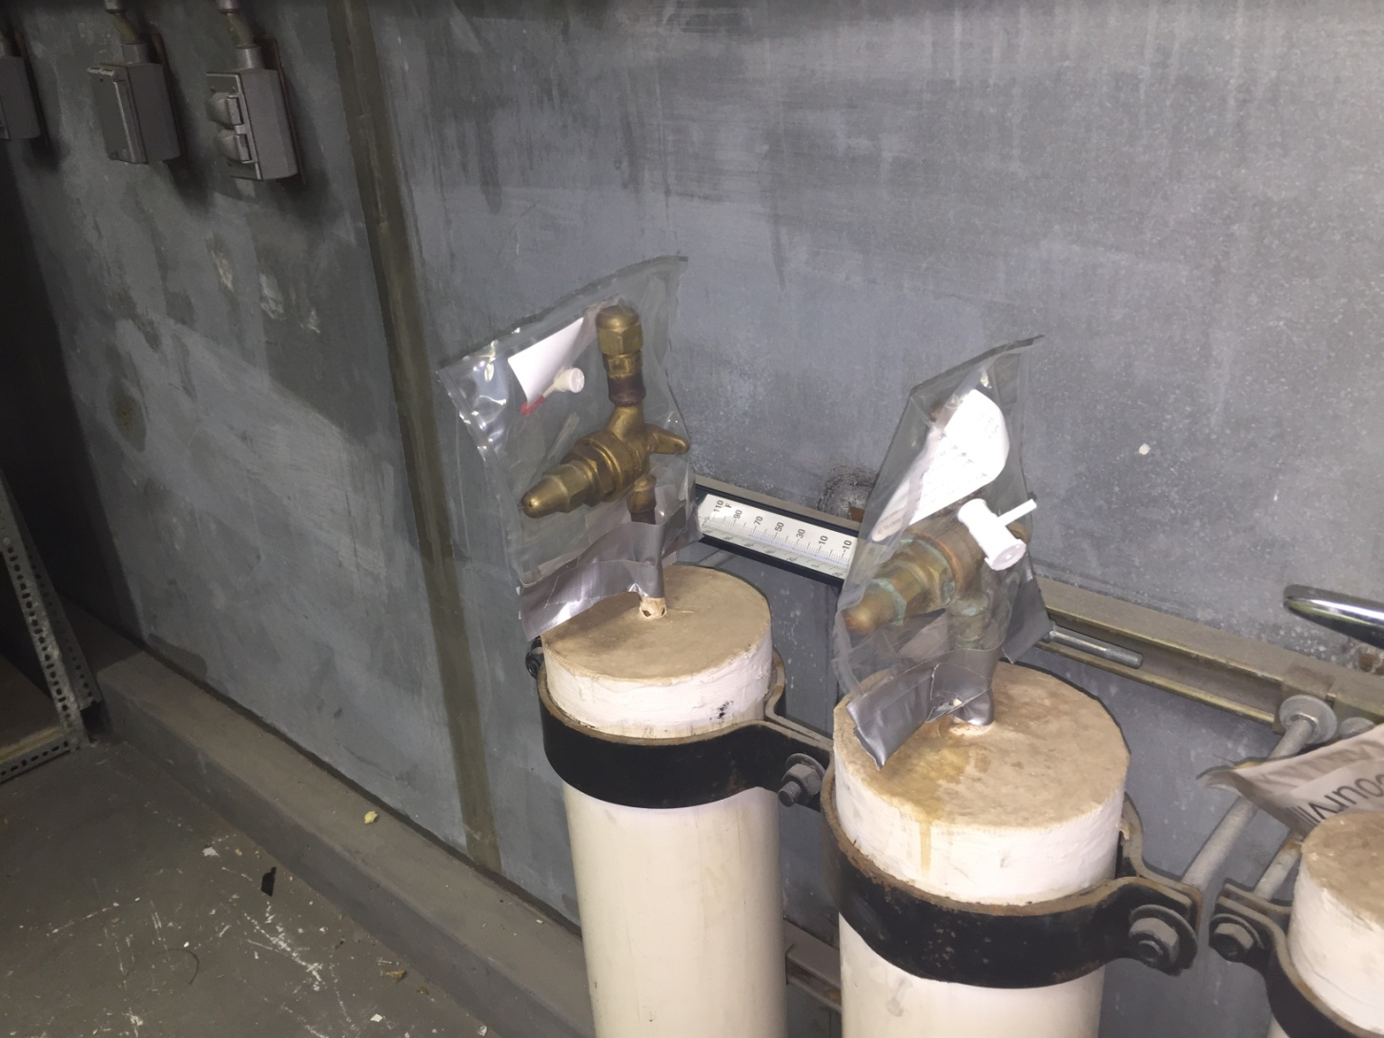
Cold Room Building Materials Evaluation

Slide 6
Peer Review II
Critical Review of ‘How We Are Doing.’
Scheduled for Next Week.
Panel of National Experts In Vapor Intrusion and Human Health Risk Assessors.
Review of Data, Methods, Approach, and Systems.
Brainstorming and Path Forward.

Slide 7
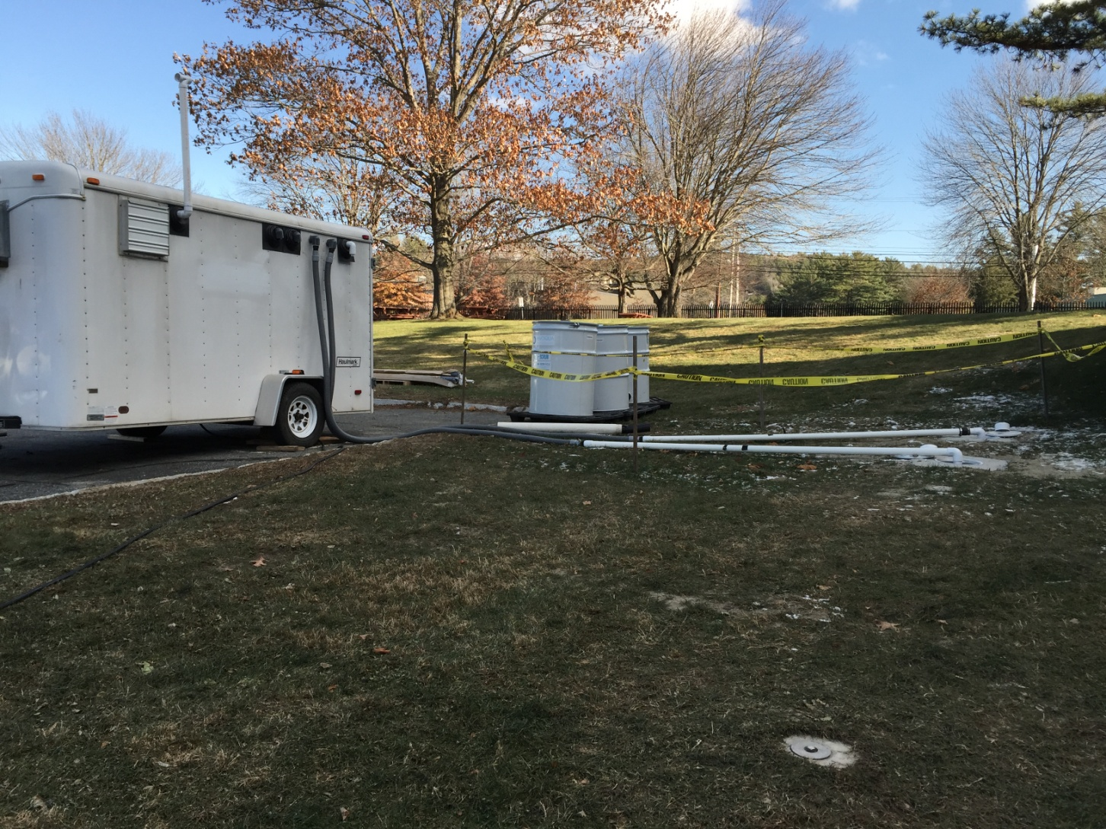
SVE System at AOC2

Slide 8
Future Work
Remedial Investigation Work
Soil Vapor Extraction Pilot Re-Start
TBD - On-Post and Off-Post Confirmation Soil Gas Sampling.
Soil Borings to be advanced below the Main Lab
Drafting the Remedial Investigation Report for Army Corps Review.

Slide 9
Future Work
Mitigation Related Work and Protection of Human Health
Peer Review II Scheduled for February 10th – 12th
Continued Real-Time Monitoring of Indoor Air Concentrations in Main Lab and Other Facility Buildings.
Continued Operation of Sub-Slab Mitigation Systems
HealthMate Air Purifier Performance Evaluation
Main Lab Roof Drain, Sanitary Sewer, and Storm Sewer Vapor Intrusion Assessment/Mitigation
Main Lab Cold Room & Building Materials Mitigation Work (-73 Line)

